Slide 1
RobinReal Challenge
Cedric Schmid
Frederic Khayat
Jad Moukaddam
William Jabbour

Slide 2




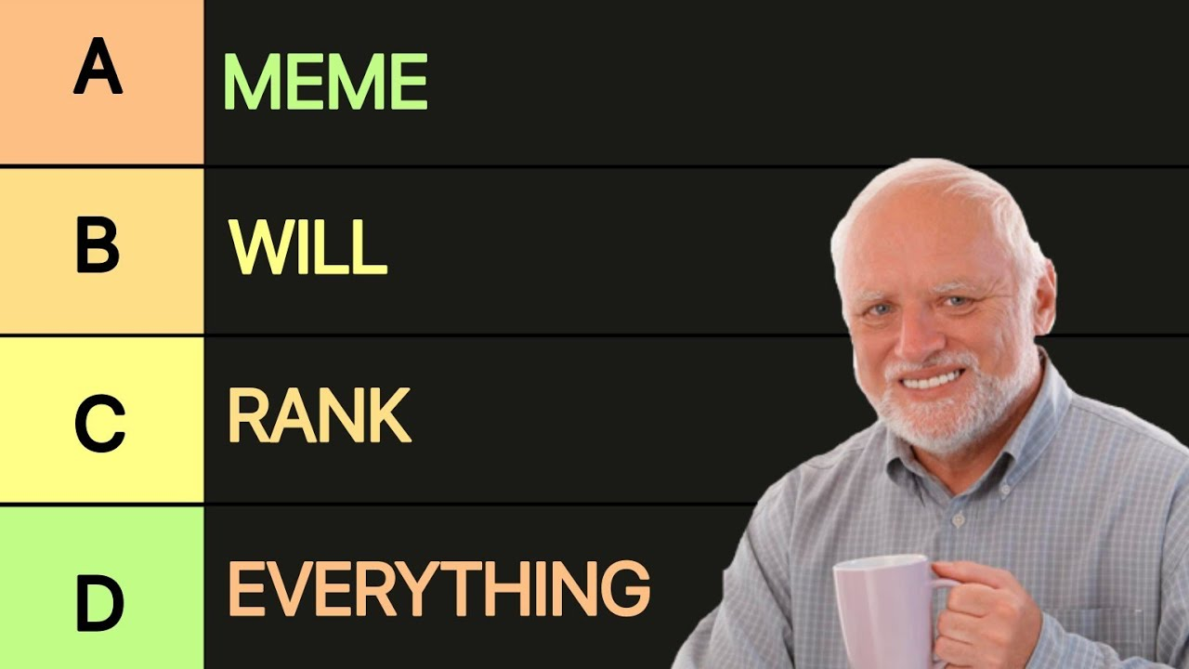


Scoring Function
Similarity Search Embedded images/descriptions enables similarity search
Data Enrichment Extract Tags from Description
Haiku
“Looking for a bright apartment with balcony in Zurich close to ETH under 3000 CHF.”
Hard Filtering Database Filter
Closeness Analysis Location Extraction
Open Street Map

Slide 3



Workflow showcase
Hosted on
User prompt: 2.5 to 3 room bright apartment in Zurich with balcony under 3200 CHF. Preferably close to ETH, pet friendly and under 80m²
Extract filters
Claude API
Hard filters: Zurich, balcony, 3200CHF, apartment
Soft filters: Bright, close to ETH, pet friendly, 80m²
Dynamic Hard Filtering - SQL
Subset of candidates for reranking
POI: Close to ETH
Rank based on score
Build weighted score
Images: Bright
Generate scores for:
Dynamic POI
Images
Text alignment
Numerical alignment
Feature flags
User can prompt modifications (conversation saved)
Text alignment
Numerical: 80m²
Feature: pet friendly

Slide 4
